Slide 1
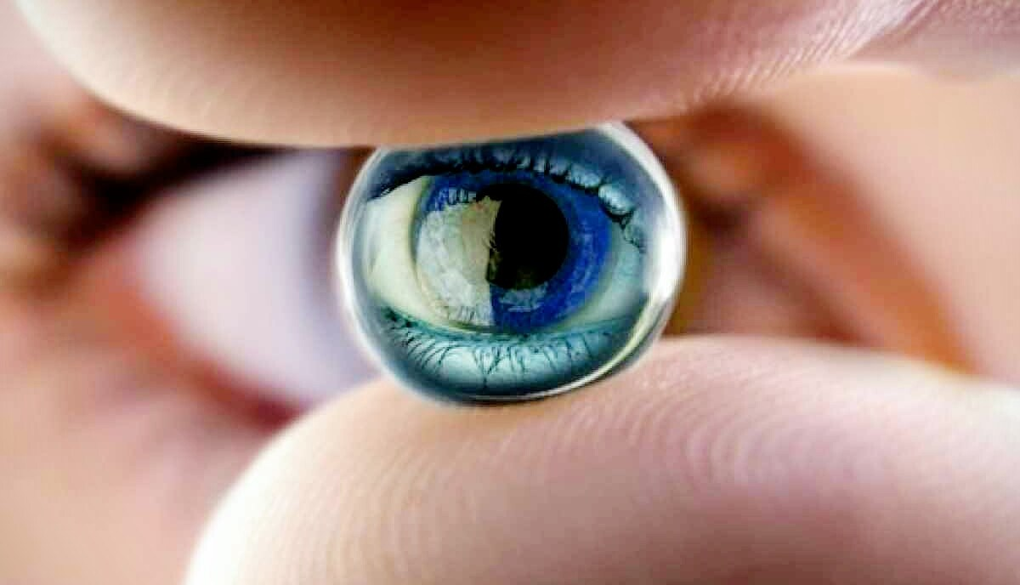
Dolcera Patent Categorization System (PCS)
analyses
Artificial Retina
Objectives:
Perform a landscape search in the area of Artificial Retina
Use PCS to derive insights and gain competitive perspective
Understand the value chain and recent M&A activities

Slide 2
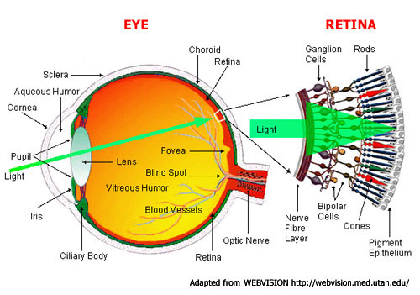
Introduction
The retina is the third and inner most light-sensitive layer of tissue.
Normal vision begins when light enters and moves through the eye to strike specialized photoreceptor cells in the retina called rods and cones.
These cells convert light signals to electric impulses that are sent to the optic nerve and the brain.
Two significant forms of blindness occur because of a loss of the photoreceptive cells of the retina, namely:
Age-related macular degeneration - results in a loss of central vision, which eliminates a person's ability to read or recognize faces
Retinitis pigmentosa - results in a slow loss of peripheral and then central vision

Slide 3
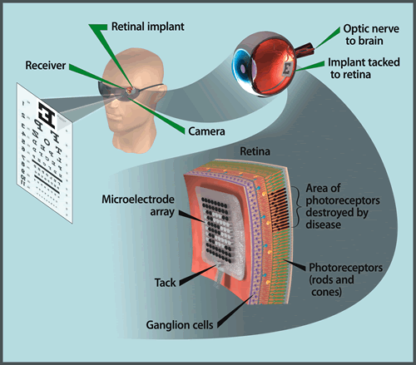
Introduction
Artificial Retina
A miniature camera mounted in eyeglasses captures images and wirelessly sends the information to a microprocessor (worn on a belt), which transmits a signal to a receiver on the eye.
The receiver sends the signals through a tiny, thin cable to the microelectrode array, stimulating it to emit pulses.
The device transmits electrical signals directly to the retina’s remaining viable cells.
The pulses travel to the optic nerve and, ultimately, to the brain.
Patients learn to interpret these visual patterns.
Artificial Retina Project

Slide 4
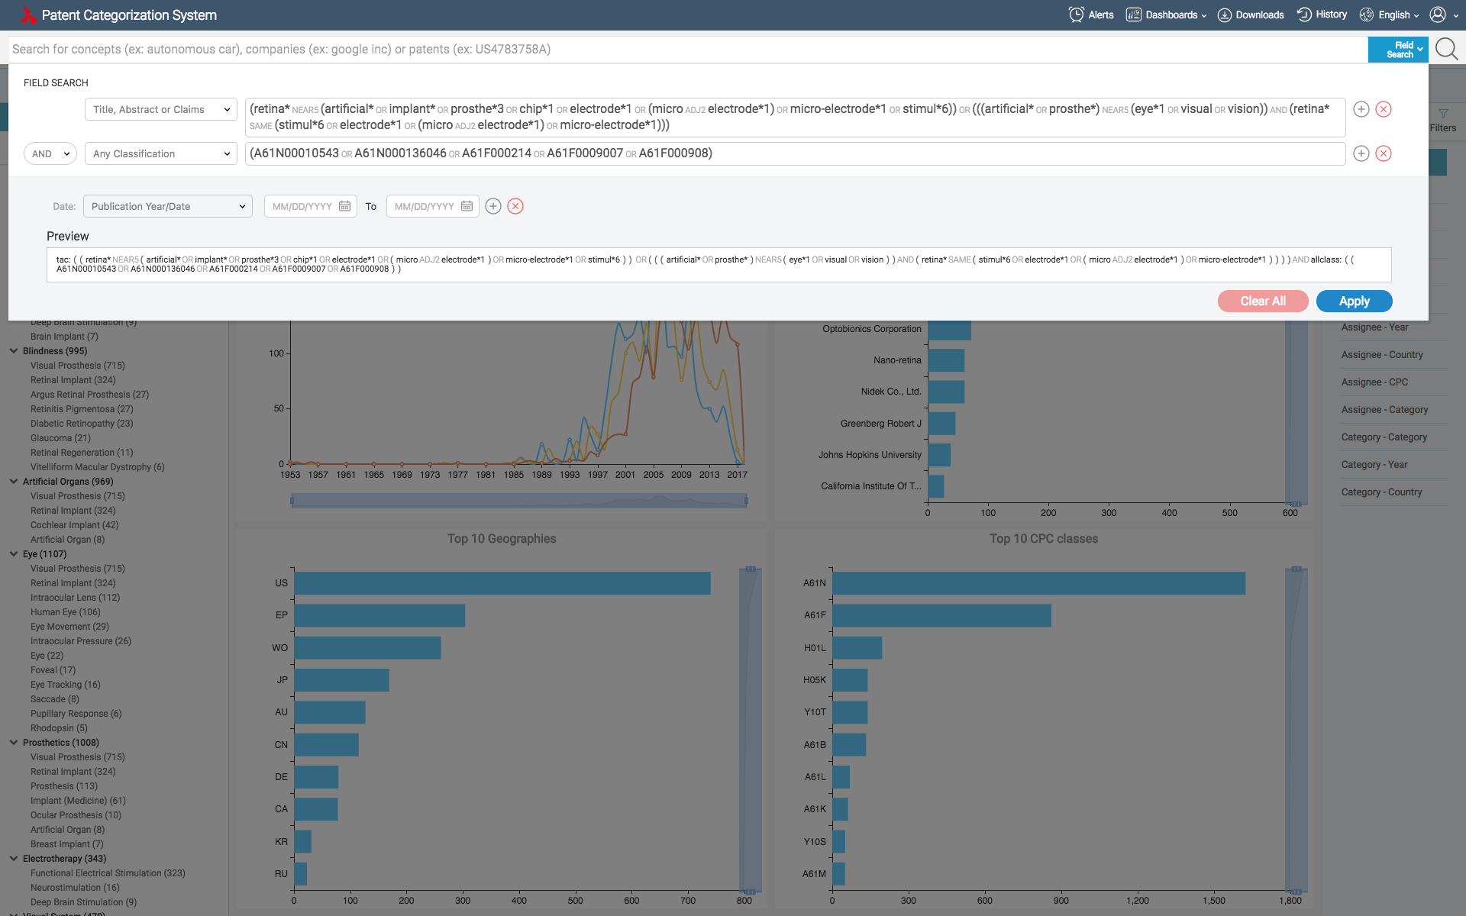
Search in PCS
The PCS search strategy was to combine ‘Artificial Vision’ keywords and ‘Retinal prosthesis’ keywords. The scope of the search was restricted to ‘tac:’ (Title-Abstract-Claims). The keywords were entered in to the Advanced search box, and were combined with related class codes.
The PCS search resulted in a total of 2029 patents, which included 554 unique patent families.
Advanced search box

Slide 5
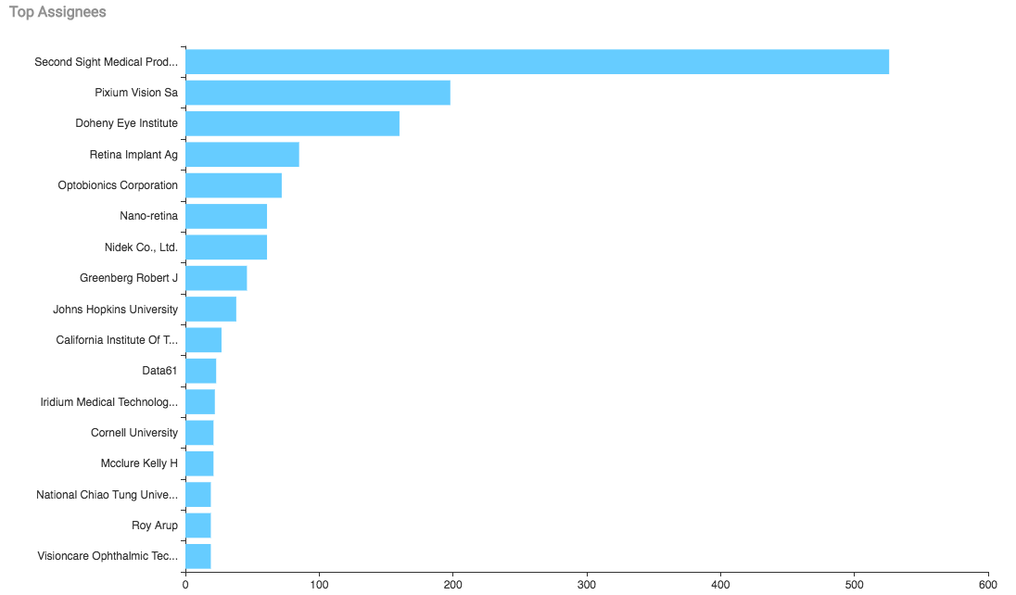
Top Assignees
The top player in the area of Artificial Retina is Second Sight Medical Products Inc. with a total of 526 patents/publications. It is followed by:
Pixium Vision SA (198)
Doheny Eye Institute (160)

Slide 6
Top Assignees - Insights
Second Sight Medical Products Inc. have patents that focus on improving the user comfort and user feedback.
Pixium Vision SA patents mostly discuss about the constructional features like, designing photodiodes, mounting and sealing features of a retinal implant.

Slide 7
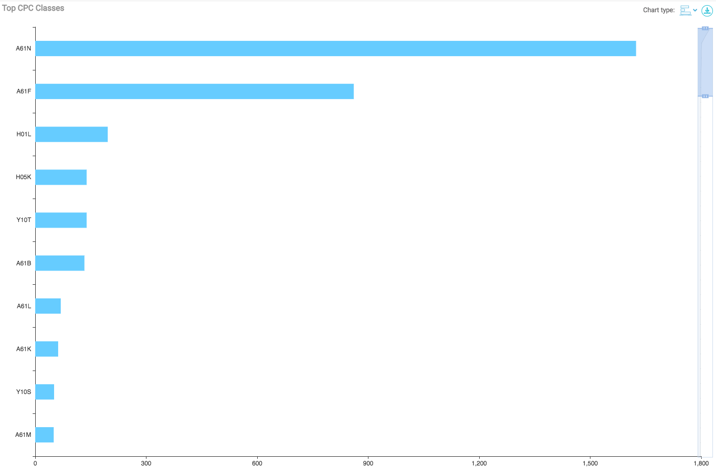
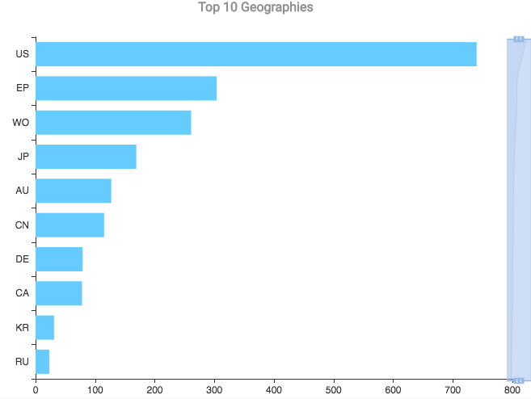
Bibliographic Insights
Top CPC codes
A61N ---> ELECTROTHERAPY; MAGNETOTHERAPY; RADIATION THERAPY; ULTRASOUND THERAPY
A61F ---> FILTERS IMPLANTABLE INTO BLOOD VESSELS; PROSTHESES; DEVICES PROVIDING PATENCY TO, OR PREVENTING COLLAPSING OF, TUBULAR STRUCTURES OF THE BODY, E.G. STENTS; ORTHOPAEDIC, NURSING OR CONTRACEPTIVE DEVICES; FOMENTATION; TREATMENT OR PROTECTION OF EYES OR EARS; BANDAGES, DRESSINGS OR ABSORBENT PADS; FIRST-AID KITS
H01L ---> SEMICONDUCTOR DEVICES; ELECTRIC SOLID STATE DEVICES NOT OTHERWISE PROVIDED FOR
H05K ---> PRINTED CIRCUITS; CASINGS OR CONSTRUCTIONAL DETAILS OF ELECTRIC APPARATUS; MANUFACTURE OF ASSEMBLAGES OF ELECTRICAL COMPONENTS
Y10T ---> TECHNICAL SUBJECTS COVERED BY FORMER US CLASSIFICATION
A61B ---> DIAGNOSIS; SURGERY; IDENTIFICATION
Geographical Distribution
Most of the patents in this technology are from US or Europe.
Japan and China top the Asian subcontinent, in the number of patent filings.

Slide 8
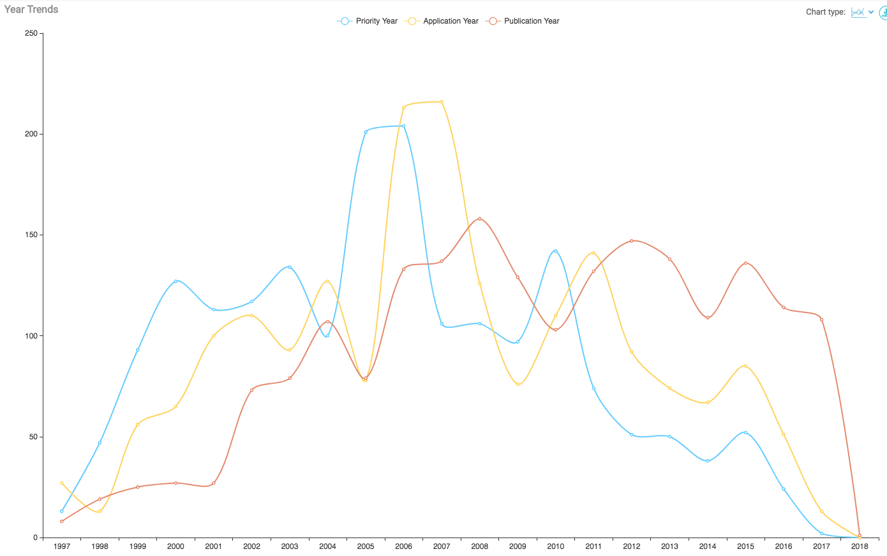
Bibliographic Insights
IP Activity
IP activity started 20 years and saw a peak in the number of publications in 2008, followed by 2012 and 2015.
The number of applications shot to the peak value during the period of 2006-2007.

Slide 9
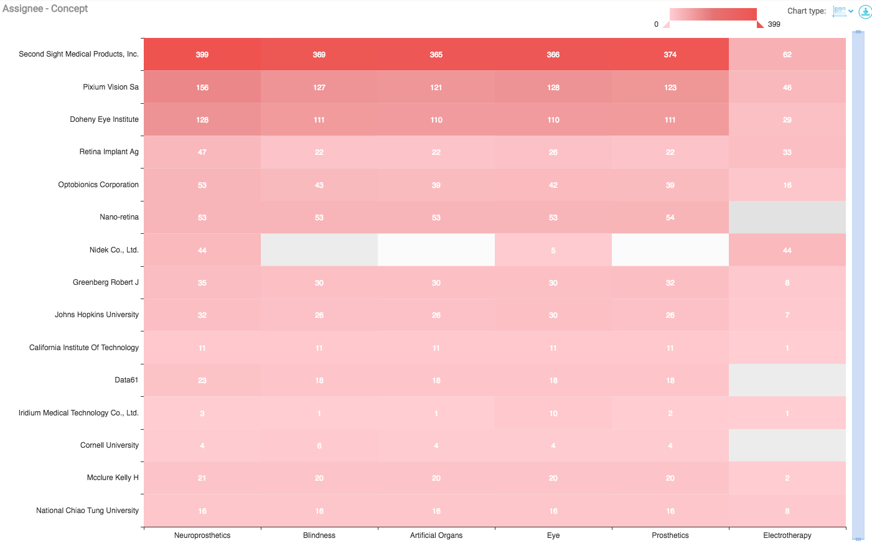
Technical Insights - Concepts Vs. Top Assignees
Second Sight Medical Products, Pixium Vision and Doheny Eye Institute patents disclose technologies related to Neuro-prosthetics, Blindness, Artificial Organs and Prosthetics.
Second Sight Medical Products, Pixium Vision has more patents on Electrotherapy.

Slide 10
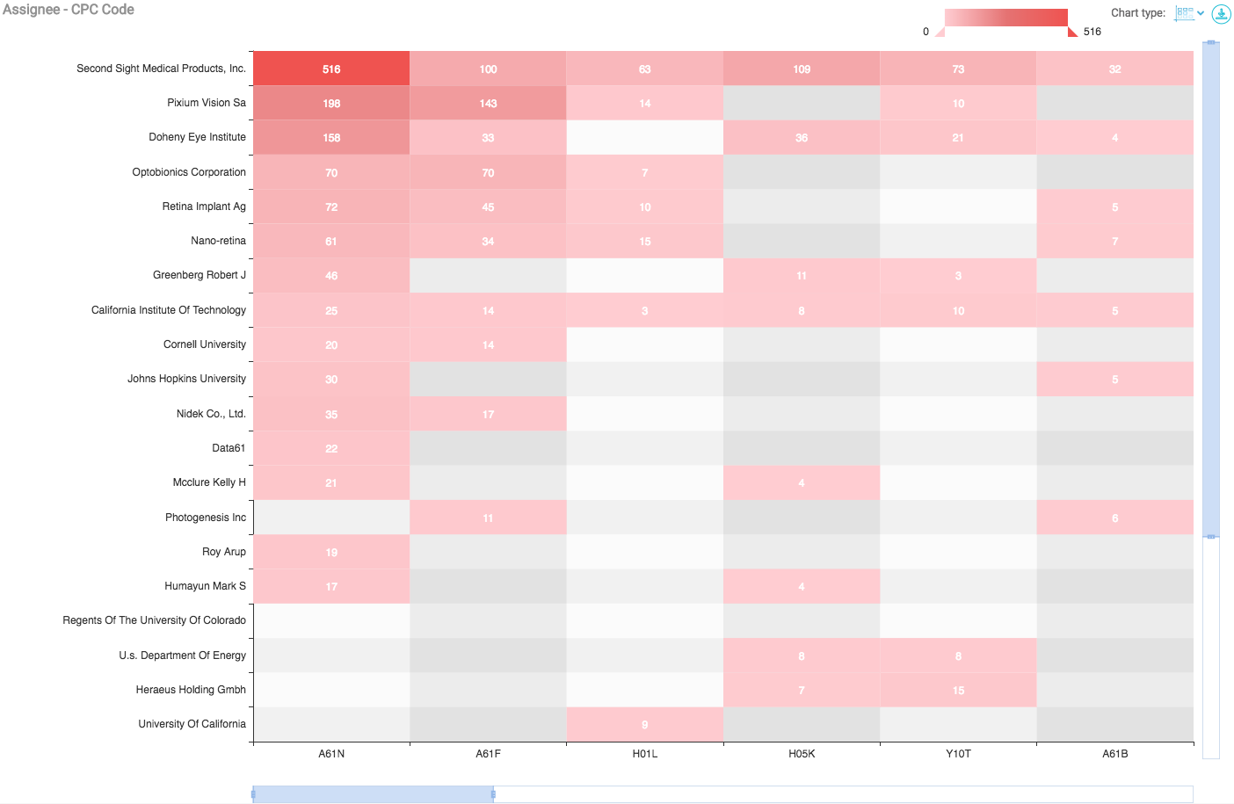
Technical Insights - CPC distribution in Top Assignees
All the product based companies- Second Sight Medical Products, Pixium Vision, Optobionics Corporation and Retina Implant AG have heavy presence on the therapy based classes- A61N, A61F, A61B.
Second Sight Medical Products has the most number of filings for the printed circuit bases class- H05K.

Slide 11
M&A activity in the space
Okuvision and Retina Implant merge together under the parent company Retina Implant AG. [Retina Implant AG, February 2017]
NIDEK -- Two Sister Companies Merge to Combine Efforts in U.S. Ophthalmic Industry. [Globenewswire, October 2005]

Slide 12
Thank you!
Request for more information or a free trial:
www.dolcera.com
info@dolcera.com ; sumair.riyaz@dolcera.com
+44-2017935041

